Slide 1
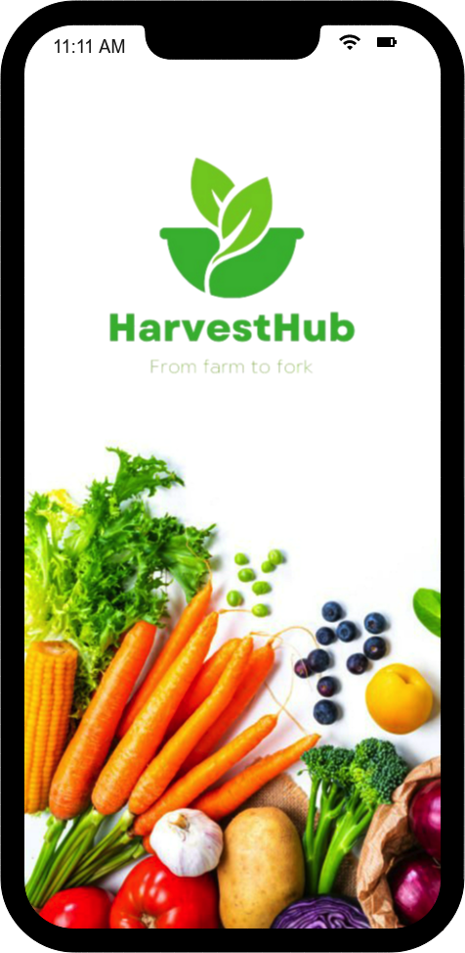
CSYE 7280 UX DESIGN/Testing -Midterm
HarvestHub – “From Farm to Fork”
Team Members
Atharva Keshre (002292694)
Atharv Joshi (002292691)
Amisha Bhawsar (002292691)

Slide 2
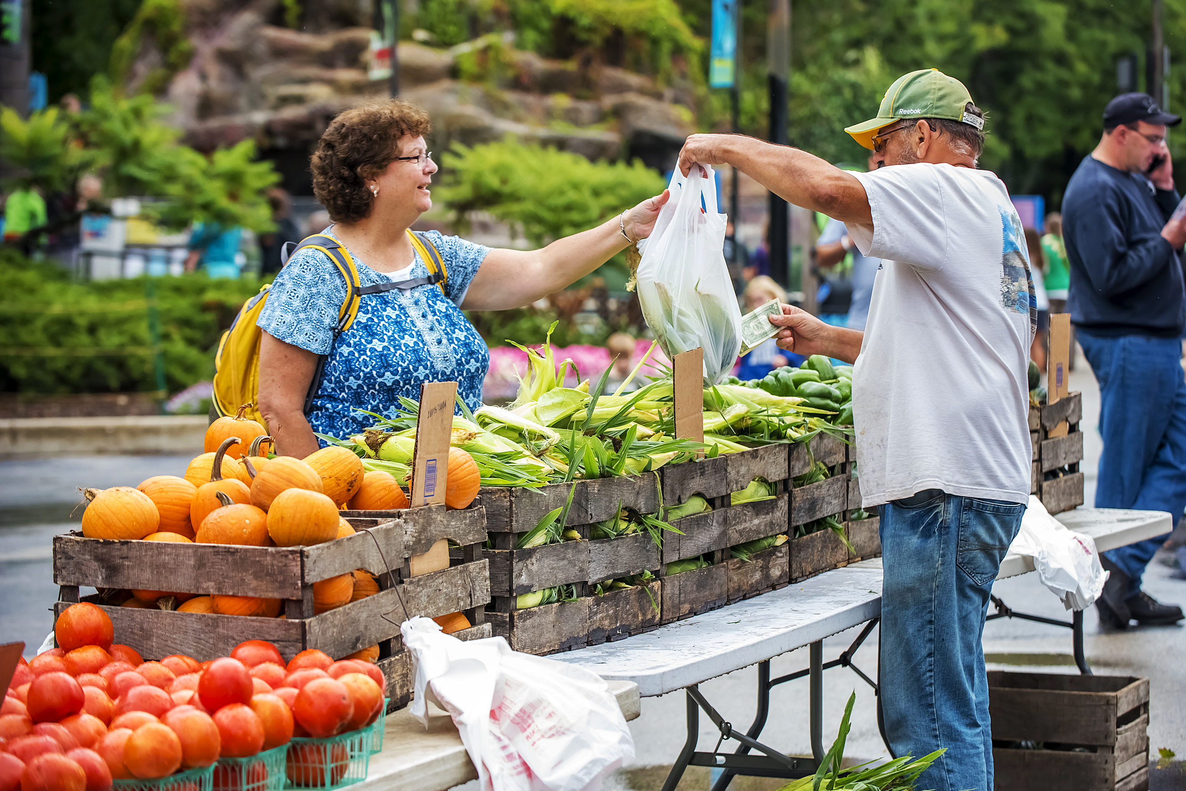
Overview
Problem Statement:
In the current food supply chain, there is a significant disconnect between farmers and consumers. Farmers often struggle to reach a broader market and obtain fair prices for their produce due to reliance on traditional distribution channels and intermediaries. Meanwhile, consumers face challenges in accessing fresh, locally sourced produce, often settling for mass-produced alternatives of unknown origin and quality. This lack of transparency and direct connection between farmers and consumers contributes to issues such as food waste, environmental degradation, and economic instability in farming communities.
Solution:
HarvestHub offers a solution by providing an online platform that directly connects farmers with consumers, bypassing traditional distribution channels and intermediaries. Through HarvestHub, farmers can easily list their fresh produce for sale, reaching a wider audience and obtaining fair prices for their products. Consumers, in turn, gain access to a wide variety of locally sourced, farm-fresh produce, with transparent information about its origin, farming practices, and nutritional value.

Slide 3
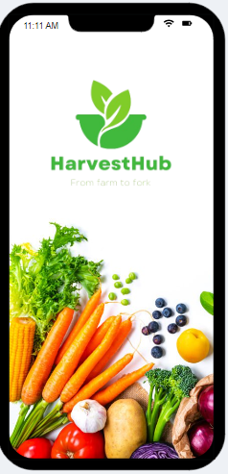
Objective
Increase
Increase Farmer Reach: Expand the market reach for small to medium-sized farmers by providing them with a platform to connect directly with consumers, thereby reducing dependence on traditional distribution channels and intermediaries.
Empower
Empower Farmers: Empower farmers to obtain fair prices for their produce and improve their economic viability by enabling them to sell their products directly to consumers through HarvestHub.
Promote
Promote Sustainability: Promote sustainable agriculture practices by highlighting farmers who prioritize environmentally friendly farming methods such as organic farming, regenerative agriculture, and permaculture.
Enhance
Enhance Consumer Access: Provide consumers with convenient access to fresh, locally sourced produce, fostering healthier eating habits and supporting local agriculture.
Facilitate
Facilitate Transparency: Foster transparency in the food supply chain by providing consumers with detailed information about the origin, farming practices, and nutritional value of the products available on HarvestHub.
Educate
Educate Consumers: Educate consumers about the benefits of buying directly from farmers, seasonal produce availability, and sustainable food choices through educational resources and informative content on the platform.
Build
Build Community: Foster a sense of community among farmers and consumers by providing interactive features such as forums, events, and recipe sharing, encouraging dialogue, knowledge exchange, and mutual support.

Slide 4
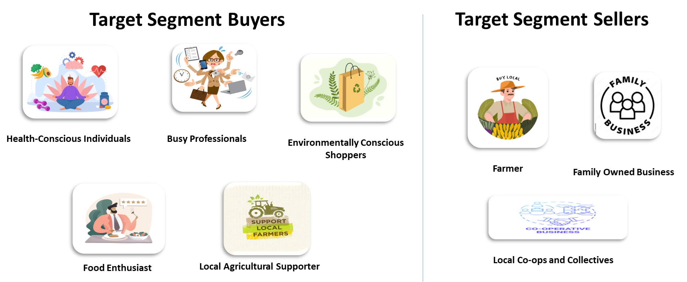
Target Audience

Slide 5

STYLE GUIDE
iPhone 11 pro
Status Bar: The status bar is a narrow horizontal bar at the top of the screen that displays various pieces of information about the device's current state.
Action Bar: The action bar, also known as the navigation bar or toolbar, is a UI element typically located at the top of the screen, just below the status bar
Tab Bar: The tab bar is a UI element that allows users to navigate between different sections or views within an app.
Nav Bar: In iOS development, the navigation bar is a UI element typically found at the top of the screen in a navigation controller hierarchy. It provides navigation controls for moving between different views or screens within an app.
Units:
Pixels/Points
Status Bar: W:355 H:20px
Tab Bar: W:355 H:26px
Screen Dimensions:
W: 355, H:971x
Button Dimensions
W: 240px X:92pz
Action Bar: W:355 H:26px
Header Font Size:
Min 30 accordingly Line height
Paragraph Font Size:
Min 14 accordingly Line height
Nav Bar: W:387 H:40px
Indicator bar

Slide 6
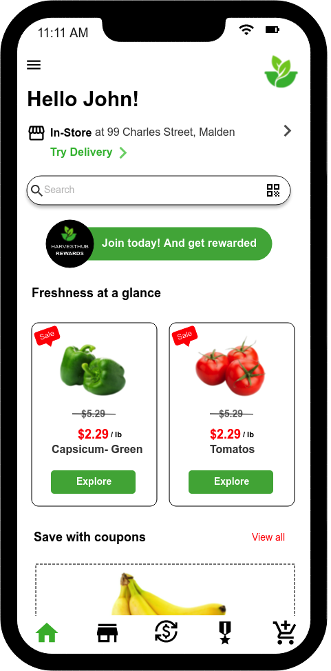
W: 23px Space at edges
Delivery Related info component
Margin for card layouts 12px gap
Space Between vertical components/Icons 48px Icon W: 40px , H: 40px
Space b/w two horizontal components

Slide 7
Colour Guide
Primary Font: Helvetica
Usage: 1. Page Title: 30px bold, Sentence case 2. Components title:- 16px Regular, Uppercase 3. Tertiary Test: 16px regular, sentence case 4. Button: w 123px H 34px
5. Text Input Needs: According to needs
Primary Colour Palette
Black: #000000
Green : #41B83D
White : #000000
Secondary Colour Palette
Secondary Font: Helvetica
Usage: 1. Page Title: 30px bold, Sentence case 2. Numbers. Non Active Components
3. Links
Black: #ff0700
Green : #e1e1e1

Slide 8

ONBOARDING
What?
Harvest Hub is a virtual farmers market app designed to connect local farmers directly with consumers, offering fresh produce and artisanal goods conveniently through a digital platform. Our service allows users to browse a wide selection of locally sourced products, place orders, and have them delivered right to their doorstep.

Slide 9
Why Onboarding
Navigate through App
Step-by-Step
Confident
Trust
Experience Smoother
Loyalty
Onboarding is necessary in Harvest Hub to ensure that users can navigate and make the most out of the app's features. During onboarding, users are guided through the process of setting up their accounts, exploring available products, understanding how to place orders, and managing their preferences such as delivery schedules and payment methods. This step-by-step introduction helps users familiarize themselves with the app, making their overall experience smoother and more enjoyable. Additionally, onboarding ensures that users feel confident and empowered to make informed decisions about their purchases, fostering trust and loyalty towards the platform.

Slide 10
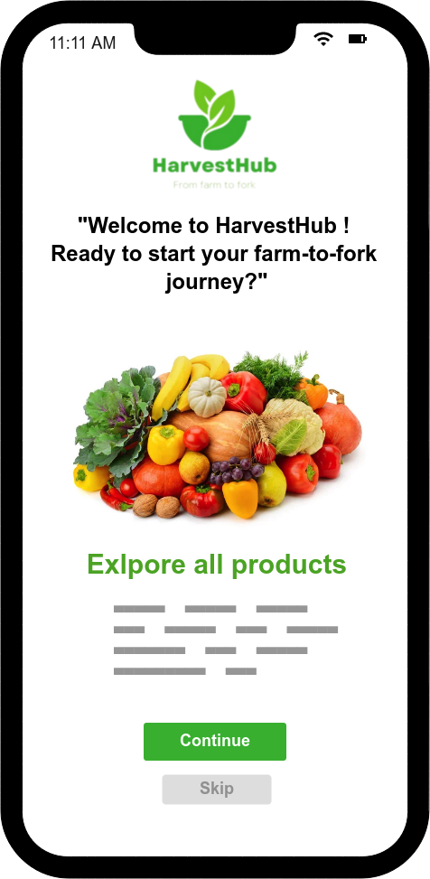
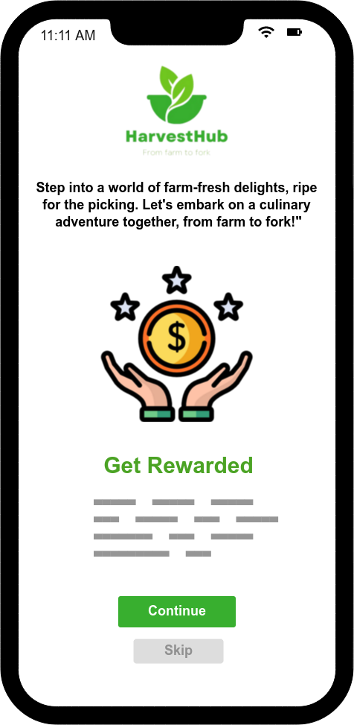

Slide 11
User Needs
Users of Harvest Hub:
Local consumers seeking fresh produce and artisanal goods.
Small-scale farmers and producers looking to expand their customer base.
Their Goals and Context:
Consumers aim to access high-quality, locally sourced products conveniently and support local farmers.
Farmers aim to reach a wider audience and increase sales without the need for a physical storefront.

Slide 12
USER NEEDS: Their Needs and Constraints
Convenience: Consumers are looking for a convenient way to purchase fresh produce and artisanal goods without having to physically visit multiple markets or farms.
Access to Local Products: Consumers want access to locally sourced products to support the local economy and reduce their carbon footprint.
Time Constraints: Busy consumers may face time constraints that prevent them from visiting traditional farmers markets or local farms during operating hours.
Market Reach: Small-scale farmers and producers may struggle to reach a broader market beyond their local community due to limited resources and marketing capabilities.
Logistical Challenges: Farmers may face logistical challenges in transporting and selling their products to distant markets or urban areas.
Financial Constraints: Both consumers and farmers may face financial constraints, and they seek a platform that offers fair pricing and value for their products and purchases.
Trust and Transparency: Consumers value transparency in the sourcing of products and seek assurance regarding the freshness and quality of the items they purchase.

Slide 13
Key features
Direct Farmer-to-Consumer Marketplace: A user-friendly platform where farmers can create profiles, list their produce, and connect directly with consumers.
Search and Filtering Tools: Intuitive search and filtering options allow consumers to easily find products based on preferences such as location, farming practices, and product type.
Secure Transactions: HarvestHub facilitates secure transactions, including online payments and options for pickup or delivery, ensuring a seamless buying experience for consumers and reliable payment for farmers.
Educational Resources: HarvestHub provides educational resources on sustainable farming practices, seasonal produce, and the benefits of buying directly from farmers, empowering consumers to make informed choices.
Community Engagement: Interactive features such as forums, events, and recipe sharing foster a sense of community among farmers and consumers, promoting dialogue, knowledge exchange, and mutual support.

Slide 14
Pain Points
Limited Market Access for Farmers:
Small and medium-sized farmers often struggle to access wider markets beyond local farmers' markets or traditional distribution channels.
Lack of visibility and marketing resources makes it challenging for farmers to reach potential customers outside their immediate vicinity.
Unfair Prices and Margins:
Farmers face price volatility and often receive low prices for their produce due to intermediaries and wholesalers taking a significant portion of the profits.
Lack of transparency in pricing and market dynamics makes it difficult for farmers to negotiate fair prices for their products.
Inconsistent Demand and Sales Channels:
Farmers experience fluctuations in demand and sales channels, leading to uncertainty in income and difficulty in planning and managing inventory.
Dependence on seasonal markets and limited distribution options restricts farmers' ability to sell their produce year-round.

Slide 15
Pain Points
Limited Access to Fresh, Local Produce:
Consumers in urban areas often struggle to access fresh, locally sourced produce, relying instead on mass-produced alternatives from supermarkets with unknown origins and quality.
Lack of convenient options for purchasing directly from farmers makes it challenging for consumers to prioritize freshness and sustainability in their food choices.
Lack of Transparency in Food Supply Chain:
Consumers are often disconnected from the sources of their food, leading to concerns about food safety, environmental impact, and ethical considerations.
Limited information about farming practices, pesticide use, and product origins leaves consumers uncertain about the quality and sustainability of the food they consume.
Limited Community Engagement:
Farmers and consumers lack opportunities to connect and engage with each other beyond transactional interactions, hindering the development of a sense of community and mutual support.
Absence of platforms for sharing knowledge, experiences, and resources limits collaboration and innovation in the agricultural sector.

Slide 16
UX Research Methods
The process of gathering information and insights about the people who will use a product or service. It involves talking to users, observing their behavior, and understanding their needs, preferences, and challenges
The goal of user research is to ensure that the final product or service meets the needs of its intended users, resulting in a better user experience and increased satisfaction.
There are different methods for conducting user research, but we are specifically utilizing SWOT analysis, competitive analysis, and the empathy technique.
SWOT
PERSONA
CREATION
COMPETETIVE ANALYSIS
EMPATHY MAP ANALYSIS
AFFINITY MAPPING
CARD SORTING

Slide 17

UX Research Methods – Reason/ Benefits
Competitive Analysis:
Benefits: Provides insights into competitors' strategies, strengths, and weaknesses.
Reason: Enables us to differentiate our product, identify market gaps, and refine our value proposition based on industry benchmarks.
Empathy Mapping:
Benefits: Fosters deeper understanding of users' needs, behaviors, and pain points.
Reason: Facilitates the creation of user-centric products, enhancing user satisfaction and adoption by addressing real user challenges effectively.
SWOT Analysis:
Benefits: Offers a comprehensive view of project's internal strengths and weaknesses, as well as external opportunities and threats.
Reason: Guides strategic decision-making, allowing us to capitalize on strengths, mitigate weaknesses, seize opportunities, and navigate potential threats effectively for project success.
User Persona:
Benefits: Creates fictional representations of target users, consolidating user research findings into actionable insights.
Reason: Helps in aligning product development with user needs, preferences, and goals, ensuring that design and features resonate with the intended audience, ultimately leading to higher user engagement and satisfaction.

Slide 18
Competitive Analysis
Competitive Analysis: HarvestHub vs. Patel Brothers vs. Local Harvest
Competitor Name | Competitor Type | Business Product Offerings | Business Size | Pricing Plans
HarvestHub | Direct competitor, as it also facilitates the direct sale of fresh produce from farmers | + Fresh crops and produce directly from local farmers. | Small to midsize, starting up and likely focusing on local markets initially. | + Transparent pricing model, possibly subscription-based for farmers or commission-based on sales.
Patel Brothers | Indirect competitor, focusing on selling South Asian grocery products. | + South Asian grocery products such as spices, grains, and specialty items. - Limited Audience | Midsize, with multiple locations and a niche market focus. | + Traditional retail pricing with occasional discounts or promotions.
LocalHarvest | Direct competitor, providing a platform for farmers to sell their produce directly to consumers. | + A variety of fresh produce, including fruits, vegetables, meats, and dairy products, sourced directly from local farmers. | Midsize, established in the market with a focus on connecting local farmers with consumers. | - Platform fees +Commission-based pricing for farmers, with varying rates depending on services offered.

Slide 19
Competitive Analysis
Competitive Analysis: HarvestHub vs. Patel Brothers vs. Local Harvest
Competitor Name | Target Audience | Unique Value Proposition | Website/App Experience | Interactions
HarvestHub | + Health-conscious consumers, supporters of local agriculture, environmentally conscious individuals. | + Direct connection to local farmers, ensuring freshness, supporting local economies, and reducing carbon footprint. | + Intuitive platform with easy navigation, focusing on showcasing farmers' produce and facilitating transactions. | Search functionality by product or farmer, secure payment options, and possibly options for pre-ordering or subscription services.
Patel Brothers | + South Asian community members, individuals interested in ethnic cuisine and specialty ingredients. | + Authentic South Asian grocery products, cultural diversity, and specialty items not commonly found in mainstream supermarkets. | + User-friendly website with clear categorization. - Limited Images - No direct link to products from the landing page | Online ordering, store locator, recipes, and customer reviews.
LocalHarvest | + Locavores, individuals seeking fresh, locally sourced produce, and those interested in supporting small-scale agriculture. | + Access to fresh, locally sourced produce, supporting small-scale farmers, and promoting sustainable agriculture practices. | + Functional website/app with emphasis on connecting consumers with local farmers. - Poor user interface - Poor use of font and colors | Search by location or product, farmer profiles, event listings, and community forums.

Slide 20
competitive analysis
Competitive Analysis: HarvestHub vs. Patel Brothers vs. LocalHarvest
Competitor Name | Visual Design | Content Classification
HarvestHub | + Clean and modern design with emphasis on showcasing the freshness and variety of produce. | + Informative content about farmers, their practices, and the benefits of buying local produce, with a friendly and inviting tone.
Patel Brothers | + Vibrant and colorful design reflecting South Asian culture, with clear product imagery and branding. | + Product descriptions, cooking tips, and cultural information presented in an engaging and informative manner, catering to the South Asian community.
LocalHarvest | + Straightforward design, focusing on usability. - Free Space on both sides of the website. -Missing images | + Educational content about local agriculture, sustainable practices, and the importance of supporting small-scale farmers, with an emphasis on community building.

Slide 21
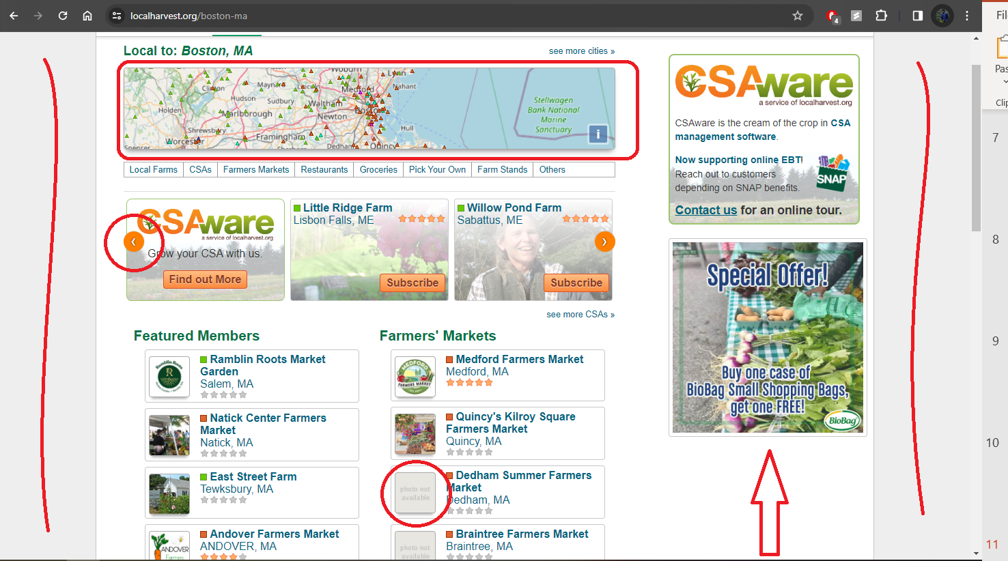
Local Harvest

Slide 22


User Persona
Name: Sarah
Age: 32
Occupation: Marketing Manager
Location: Suburban area
Background: Sarah is health-conscious and environmentally aware. She values fresh, locally sourced produce but often struggles to find such options at her local grocery store. Sarah wants to support small-scale farmers and make sustainable food choices but finds it challenging to access farm-fresh produce due to limited options and lack of transparency in the food supply chain.
Goals and Needs:
Access to Fresh, Locally Sourced Produce: Sarah wants convenient access to farm-fresh produce without having to visit multiple farmers' markets or specialty stores.
Support for Sustainable Agriculture: Sarah is passionate about supporting sustainable agriculture practices and wants to purchase products from farmers who prioritize environmentally friendly farming methods.
Transparency and Information: Sarah values transparency in the food supply chain and wants detailed information about the origin, farming practices, and nutritional value of the products she purchases.
Community Engagement: Sarah is interested in connecting with local farmers and like-minded consumers to share knowledge, recipes, and experiences related to sustainable food choices.
Convenience and Efficiency: Sarah seeks a user-friendly platform that makes it easy to browse, purchase, and track orders of farm-fresh produce, saving her time and effort.
Name: Alex
Age: 35
Occupation: Software Engineer
Location: Suburban area
Background: Alex leads a busy lifestyle, juggling work and family responsibilities. As a health-conscious individual, he prioritizes fresh, nutritious food for himself and his family. However, he often struggles to find high-quality produce that meets his standards at his local grocery store. Alex is also passionate about supporting local farmers and sustainable food practices but finds it challenging to access farm-fresh options in his area.
Goals and Needs:
Quality and Freshness: Alex wants access to high-quality, fresh produce for himself and his family, ensuring they maintain a healthy diet.
Sustainability: Alex is committed to supporting sustainable food practices and wants to purchase products from farmers who prioritize environmental stewardship.
Convenience: As a busy professional, Alex values convenience and seeks a hassle-free way to purchase farm-fresh produce without having to visit multiple stores or farmers' markets.
Transparency: Alex values transparency in the food supply chain and wants to know the origin, farming practices, and handling of the products he purchases.
Family Engagement: Alex wants to involve his family in the food-buying process and educate them about the importance of supporting local farmers and making sustainable food choices.

Slide 23
Wide Variety of Products: HarvestHub offers a diverse range of fresh produce, artisanal goods, and locally sourced products, catering to various consumer preferences and dietary needs.
Direct Connection with Farmers and Vendors: By facilitating direct transactions between consumers and local farmers/vendors, HarvestHub fosters transparency, trust, and a sense of community.
Convenient Shopping Experience: The virtual platform provides a convenient shopping experience for consumers, allowing them to browse, purchase, and schedule delivery or pickup of fresh groceries from the comfort of their homes.
SWOT ANALYSIS
Limited Geographic Coverage: Harvesthub's reach may exclude consumers beyond specific regions interested in accessing fresh, locally sourced products.
Dependency on Farmer and Vendor Participation: Harvesthub's success hinges on local farmers' and vendors' cooperation, with disruptions impacting reliability and selection.
Logistical Challenges: Managing inventory, deliveries, and product freshness poses logistical hurdles requiring efficient management for customer satisfaction.
WEAKNESS
STRENGTHS
Competition from Traditional Retailers: Harvesthub faces competition from established grocery retailers, supermarkets, and online platforms, necessitating differentiation and competitive pricing.
Seasonal and Weather-Related Challenges: Harvesthub must navigate seasonal fluctuations and weather disruptions, requiring flexibility and contingency planning in supply chain management.
Regulatory and Compliance Issues: Compliance with food safety regulations and health standards is crucial for maintaining consumer trust, necessitating adherence to licensing requirements and proactive quality control measures.
Expansion to New Markets: Harvesthub can broaden its reach and brand awareness by partnering with farmers/vendors in new regions, tapping into diverse customer bases.
Integration of Technology: Incorporating tech like mobile apps and AI can enhance shopping experiences and provide valuable consumer insights for Harvesthub.
Collaboration with Local Communities: Engaging in local events and markets can bolster Harvesthub's visibility, partnerships, and community engagement, strengthening its brand presence.
THREATS
OPPORTUNITIES

Slide 24
Empathy Map: Amisha – A College Student
Goals:
Says:
Thinks:
"I'm always looking for healthy food options that fit my budget."
"I want to eat healthy, but it's tough to get farm fresh organic food."
“I wish there was a convenient way to buy fresh produce without spending too much time shopping.”
"Finding organic farm fresh food options should be easier."
Eat healthier without breaking the budget.
"I wish I had more time to cook fresh meals instead of relying on fast food."
Find convenient ways to incorporate fresh produce into meals.
"I wonder if buying directly from farmers would be more cost-effective and ethical."
Does:
Feels:
Support local farmers & promote sustainability in food choices.
Shops for groceries on a budget, often opting for convenience over freshness.
Balances studies, work, and personal life, leaving little time for extensive grocery shopping.
Frustrated by the lack of affordable and convenient options for buying fresh produce.
Guilty about not eating as healthily as she would like.
Simplify the grocery shopping process to save time and reduce stress.
Prepares simple meals at home, trying out new recipes found online.
Overwhelmed by the demands of college life and balancing work, studies, & personal time.

Slide 25
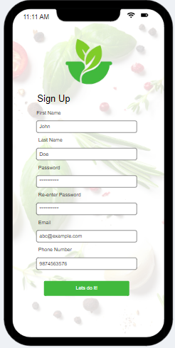
Use Cases
Lightweight Use Cases:
Quick Signup Process
Actor: New User
Overview: This use case covers the process of a new user quickly signing up for an account on HarvestHub.
Subject Area: User Registration
Trigger: User clicks on the "Sign Up" button on the app homepage.
Basic Flow:
User enters basic information such as name, email, and password.
The system validates the entered information and creates a new user account.

Slide 26
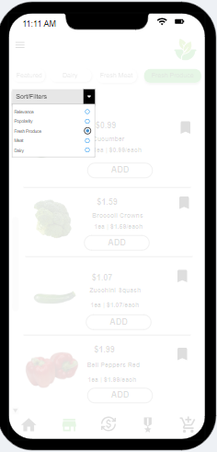
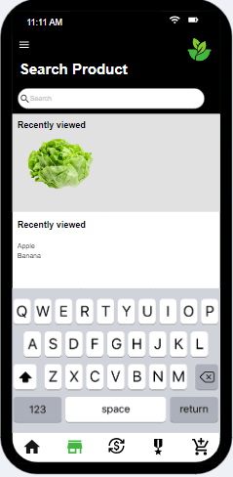
Use case
2. Effortless Product Search
Actor: Registered User
Overview: This use case involves a user effortlessly searching for products on HarvestHub.
Subject Area: Product Search
Trigger: User enters a search query in the search bar.
Basic Flow:
User enters a search query for specific products or categories.
The system quickly retrieves relevant search results based on the query.
User can browse through the search results and view product details.

Slide 27
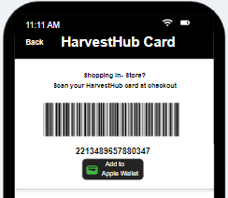
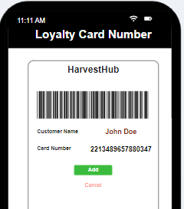
Middleweight Use Cases:
1. Secure Payment Processing
Actor: Registered User
Overview: This use case involves securely processing payments for purchases made on HarvestHub.
Subject Area: Payment Processing
Basic Flow:
User selects preferred payment method (e.g., credit/debit card, Apple Pay).
The system securely processes the payment transaction using encryption technology.
Alternate Flow (Failed Transaction):
If the payment transaction fails (e.g., insufficient funds, declined card), the system notifies the user.
User is prompted to select an alternate payment method or update payment details.
User retries the payment transaction with the updated information.
The system securely processes the revised payment transaction.
Alternate Flow (Security Verification):
If the payment method requires additional security verification (e.g., 3D Secure authentication), the system prompts the user to authenticate.
User completes the security verification process (e.g., entering OTP, biometric authentication).
The system verifies the security credentials and securely processes the payment transaction.

Slide 28
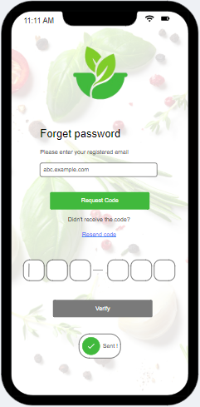
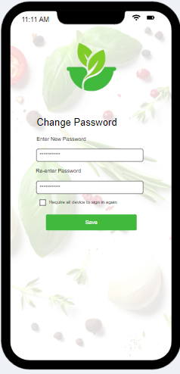
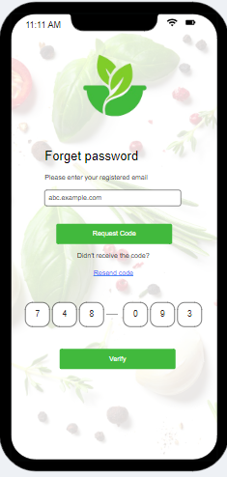
Use Cases
2 . Password Reset via Email OTP
Actor: Registered User
Overview: This use case covers the process of resetting the password for a user who has forgotten their login credentials using an email-based one-time password (OTP).
Subject Area: User Authentication
Preconditions: User has forgotten their password and is unable to log in.
Basic Flow:
User clicks on the "Forgot Password?" link on the login screen.
The system prompts the user to enter their registered email address.
User enters their email address and submits the form.
User checks their email inbox and retrieves the OTP.
User enters the OTP in the app.
The system validates the OTP and allows the user to reset their password.
User enters a new password and confirms the password change.
The system updates the user's password and confirms the successful password reset.
Postconditions: User receives confirmation of the password reset and can now log in using their new password.
Alternate Flow (Invalid Email):
If the entered email address is not registered or invalid, the system notifies the user to provide a valid email address.
User re-enters a valid email address and resubmits the form.
The system proceeds with the password reset process as per the basic flow.

Slide 29
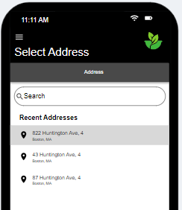
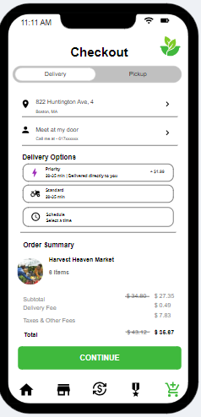
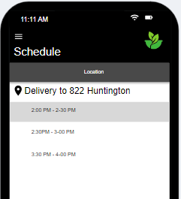
Use Cases
Heavyweight Use Case:
1. Efficient Order Fulfillment with Delivery Option
Actor: Registered User
Overview: This use case covers the process of efficiently fulfilling orders with the option for users to schedule deliveries for their purchases.
Subject Area: Order Fulfillment
Trigger: User selects the option for delivery during checkout.
Preconditions: User has added items to the shopping cart and proceeded to checkout.
Basic Flow:
CONTINUED ON NEXT PAGE

Slide 30
Basic Flow:
User selects the option for delivery during checkout.
The system prompts the user to set their delivery location, providing options for home or office addresses saved in the user's profile or allowing manual entry.
User selects the preferred delivery location or enters a new address manually.
The system calculates the estimated delivery time based on the user's location and current traffic conditions. User specifies the desired delivery time from available time slots or requests immediate delivery.
User reviews the order summary, including selected items, delivery details, and applied discounts. User proceeds to checkout and confirms the order.
Postconditions: User receives a confirmation of the scheduled delivery, including the estimated delivery time and order details. The system initiates the order fulfillment process, preparing the items for delivery within the specified timeframe.
Alternate Flow 1 (Invalid Address):
If the user enters an invalid or unrecognized address, the system prompts the user to correct the address.
User revises the delivery address or selects an alternative address from their saved locations.
The system verifies the updated address and recalculates the estimated delivery time accordingly.
Alternate Flow 2 (Delivery Time Change):
If the user wishes to change the scheduled delivery time after confirming the order, they can do so through the app.
User accesses the order details or delivery settings and selects the option to modify the delivery time.
The system presents available time slots for rescheduling or allows the user to request immediate delivery.
User selects the new delivery time and confirms the change. The system updates the order details accordingly

Slide 31
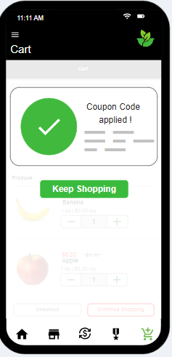
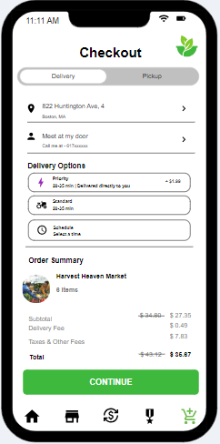
Use Cases
Rewards and Coupons Integration
Actor: Registered User
Overview: This use case enables users to utilize rewards points and apply coupons during checkout for discounted purchases.
Subject Area: Rewards and Discounts
Trigger: User selects items for purchase and proceeds to checkout.
Preconditions: User has rewards points and/or valid coupons.
Basic Flow:
User selects items for purchase and proceeds to checkout.
System displays available rewards points and coupons.
User chooses rewards points or coupons.
System applies selected rewards points and/or coupons, calculating discounts.
User confirms discounted order and proceeds to payment.

Slide 32
Postconditions: User receives confirmation of applied rewards points and/or coupons, with the discounted total displayed for checkout.
Alternate Flow 1 (No Available Coupons):
If the user does not have any valid coupons at the time of checkout, the system notifies the user that no coupons are available.
User proceeds with the purchase without applying any coupons.
Alternate Flow 2 (Coupon Redemption Error):
If the user attempts to apply an invalid or expired coupon, the system prompts the user to correct the coupon information.
User revises the coupon code or selects an alternative coupon from the available options.
The system verifies the updated coupon and recalculates the discounted total accordingly

Slide 33

Conclusion
HarvestHub aims to change how food gets from farms to tables. It helps farmers sell their produce directly to people like you and me. This means farmers can reach more customers and get fair prices for their food. For us, it means we can easily buy fresh, local food and know exactly where it comes from. HarvestHub also brings farmers and shoppers together, helping us learn about how our food is grown and supporting healthy eating. It's not just a website—it's a way to make food better for everyone.

Slide 34


